Slide 1

Heavy Lifting in the Cloud
with
Spring Batch
Notes:
http://www.flickr.com/photos/zachd1_618/3477986245/

Slide 2

Notes:
http://jamesjoe.com/joe-taylor/articles/son-of-man-wallpaper.asp

Slide 3


Slide 4


Slide 5

SPRING
Batch
Overview

Slide 6

Notes:
http://www.flickr.com/photos/liberato/204396279/

Slide 7

Notes:
http://www.flickr.com/photos/lenscrack/5239427936/

Slide 8


Slide 9
SPRING
Batch
Overview

Slide 10


Slide 11
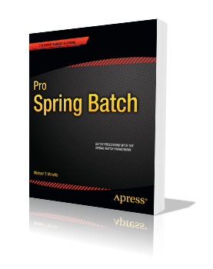
Batch processing, … is defined as the processing of data without interaction or interruption.

Slide 12
Potential Use Cases
Nightly batch processing
ETL processing
Multithreaded processing
Master/Slave configurations
Vulnerability Scanners?

Slide 13


Slide 14
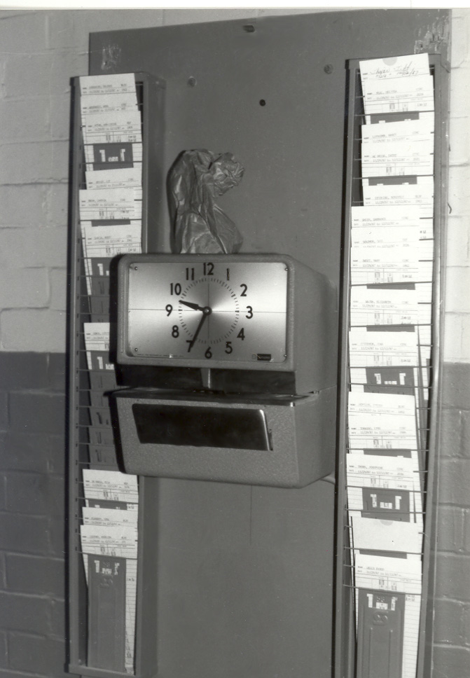
What is a Job?
Notes:
http://www.flickr.com/photos/ppl_ri_images/4019834273/
A Job is the definition of a process to be executed from start to finish without interruption.

Slide 15

What is a Step?
Notes:
http://www.flickr.com/photos/judepics/2371279935/

Slide 16

What is an Item?

Slide 17
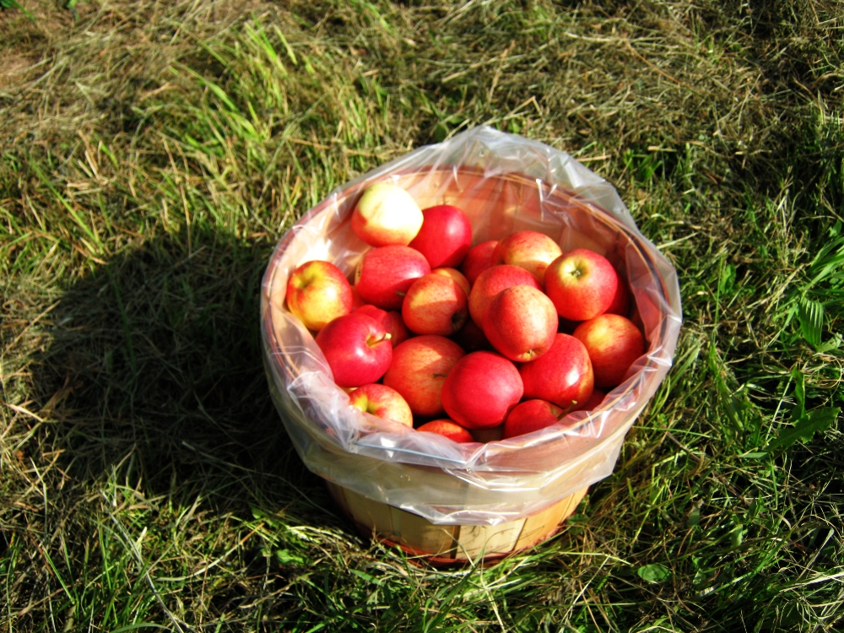
What is a Chunk?
Notes:
http://www.flickr.com/photos/allthingsmichigan/3947671573/

Slide 18
Step1
Step2
Step3
ItemReader
ItemReader
ItemReader
ItemProcessor
ItemProcessor
ItemProcessor
ItemWriter
ItemWriter
ItemWriter

Slide 19
Features include:
Transaction management
Chunk based processing
Declarative I/O
Start/Restart/Skip capabilities
Web administration interface
Based on the Spring framework
Notes:
Reusable components for the following
Chunk based processing
I/O – Declaritive
Start/Restart/Skip capabilities
Transaction management
Web administration interface

Slide 20


Slide 21
Notes:
http://www.flickr.com/photos/liberato/204396279/

Slide 22
MultiThreaded Step
Step1
Step2
Step3
Step2
Step2
ItemReader
ItemReader
ItemReader
ItemReader
ItemReader
ItemProcessor
ItemProcessor
ItemProcessor
ItemProcessor
ItemProcessor
ItemWriter
ItemWriter
ItemWriter
ItemWriter
ItemWriter

Slide 23
Parallel Steps
Step2a
ItemReader
ItemProcessor
Step1
Step3
ItemWriter
ItemReader
ItemReader
ItemProcessor
ItemProcessor
ItemWriter
Step2b
ItemWriter
ItemReader
ItemProcessor
ItemWriter

Slide 24
Remote Chunking
Step1
Step2
Step3
ItemReader
ItemReader
ItemReader
ItemProcessor
ItemProcessor
ItemWriter
ItemWriter
ItemWriter
Step2a
Step2a
Step2a
ItemReader
ItemReader
ItemReader
ItemProcessor
ItemProcessor
ItemProcessor
ItemWriter
ItemWriter
ItemWriter

Slide 25
Partitioning
Step1
Master
Step3
ItemReader
ItemReader
ItemProcessor
ItemProcessor
ItemWriter
ItemWriter
Slave1
Slave2
Slave3
ItemReader
ItemReader
ItemReader
ItemProcessor
ItemProcessor
ItemProcessor
ItemWriter
ItemWriter
ItemWriter

